Slide 1
Next week
1-on-1 interviews
CGI on an ice-free Arctic

Slide 2
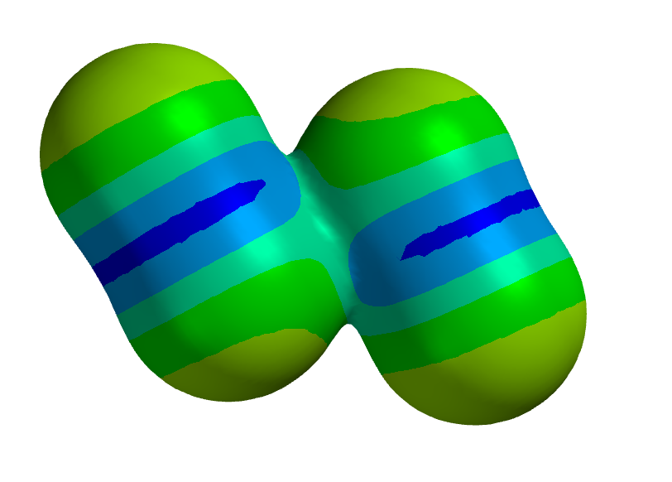
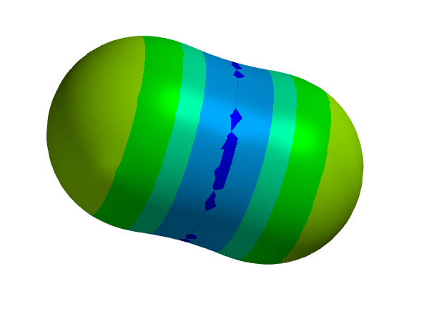
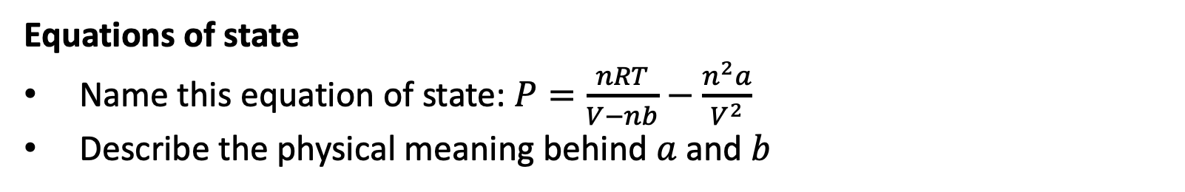

Week 1 (this is a sampler, not necessarily what I’ll ask you)
The E-format convention
Define a variable $R=8.314×{10}^{−3}$using the E-format convention
Intermolecular bond strengths
What do the colors mean in these electrostatic potential maps?
Equations of state
Name this equation of state: $P=\frac{nRT}{V−nb}−\frac{n^{2}a}{V^{2}}$
Describe the physical meaning behind $a$ and $b$

Slide 3
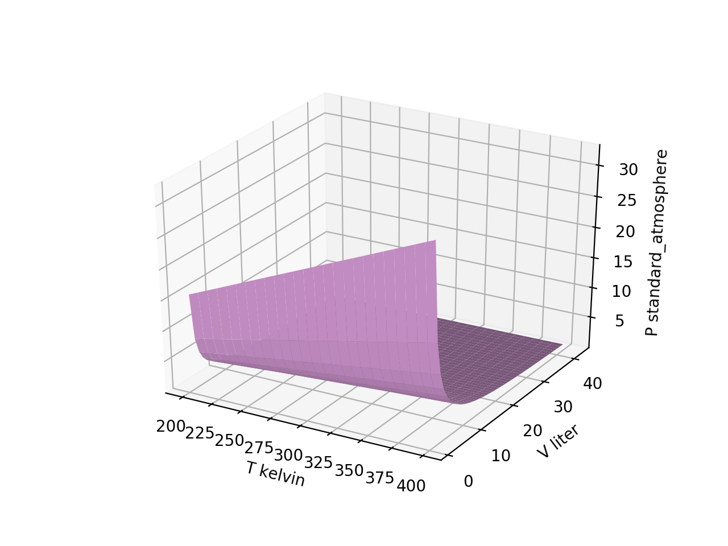
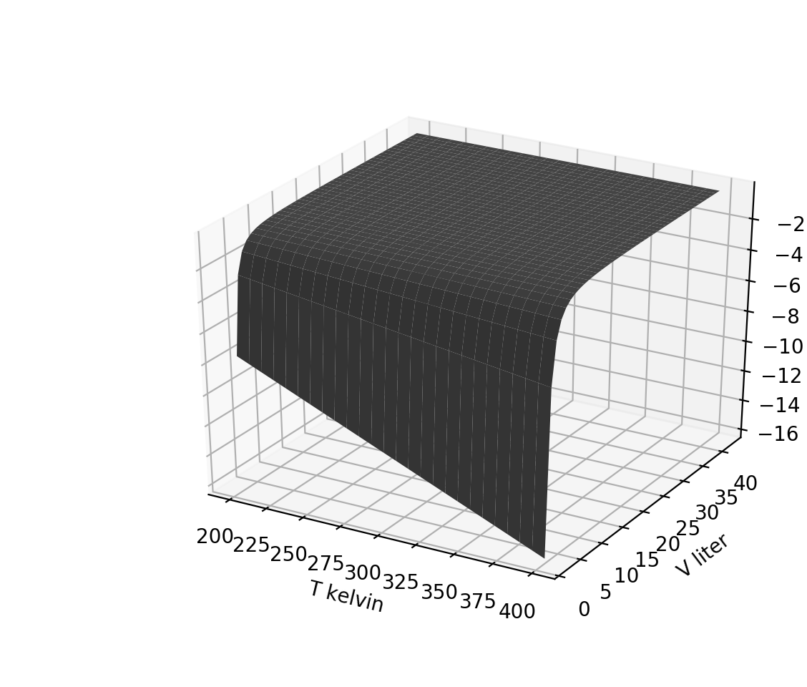
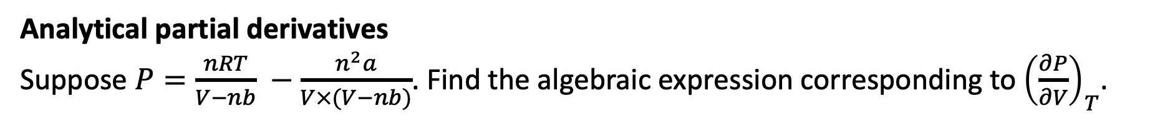
Week 2 (this is a sampler, not necessarily what I’ll ask you)
1. ${\left(\frac{∂P}{∂V}\right)}_{T}$
Visualizing derivative thermodynamic surfaces, part 1
Which thermodynamic surface is the one on the right?
$2. {\left(\frac{∂P}{∂T}\right)}_{V}$
${3. \left(\frac{∂T}{∂V}\right)}_{T}$
$$P(T,V)$$
${4. \left(\frac{∂T}{∂T}\right)}_{V}$
Analytical partial derivatives
Suppose $P=\frac{nRT}{V−nb} −\frac{n^{2}a}{V×(V−nb)}$. Find the algebraic expression corresponding to ${\left(\frac{∂P}{∂V}\right)}_{T}$.

Slide 4

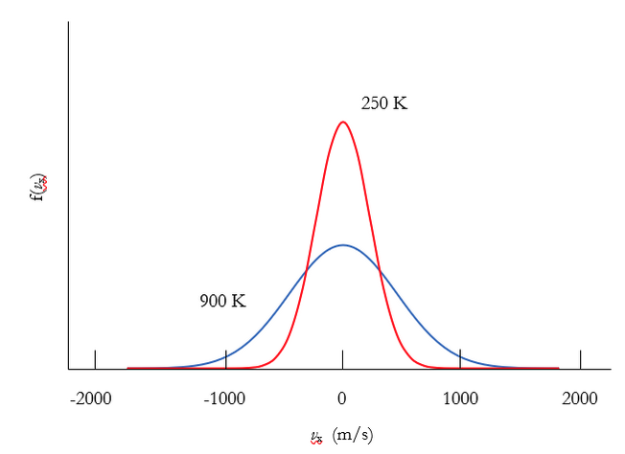
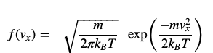
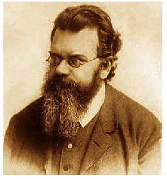
Week 3 (this is a sampler, not necessarily what I’ll ask you)
Probability densities
Which graph below corresponds to the heavier molecule?

Slide 5
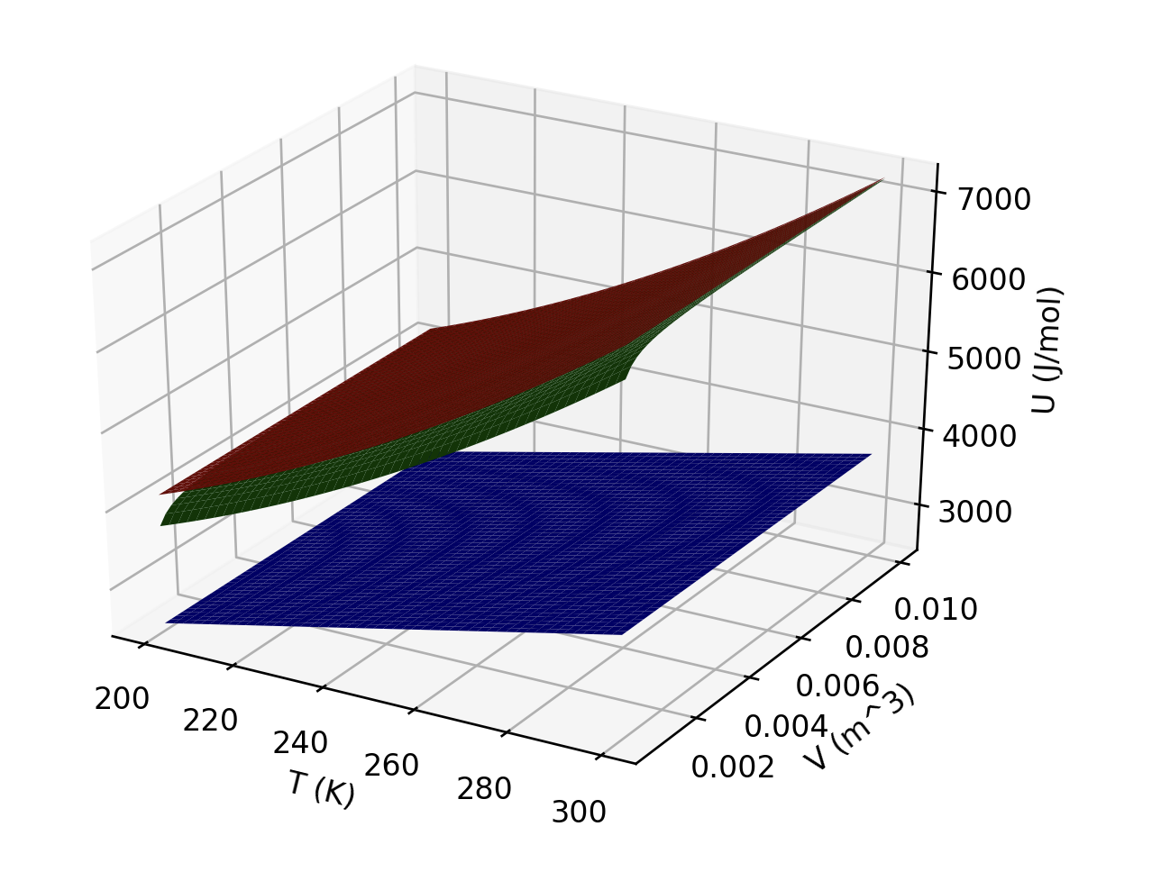
Week 4 (this is a sampler, not necessarily what I’ll ask you)
Interpreting U(T,V)
What is responsible for the curvature of the red and green gases in the temperature direction?
Which gas(es) could be ideal?
Which is probably a monatomic gas?

Slide 6
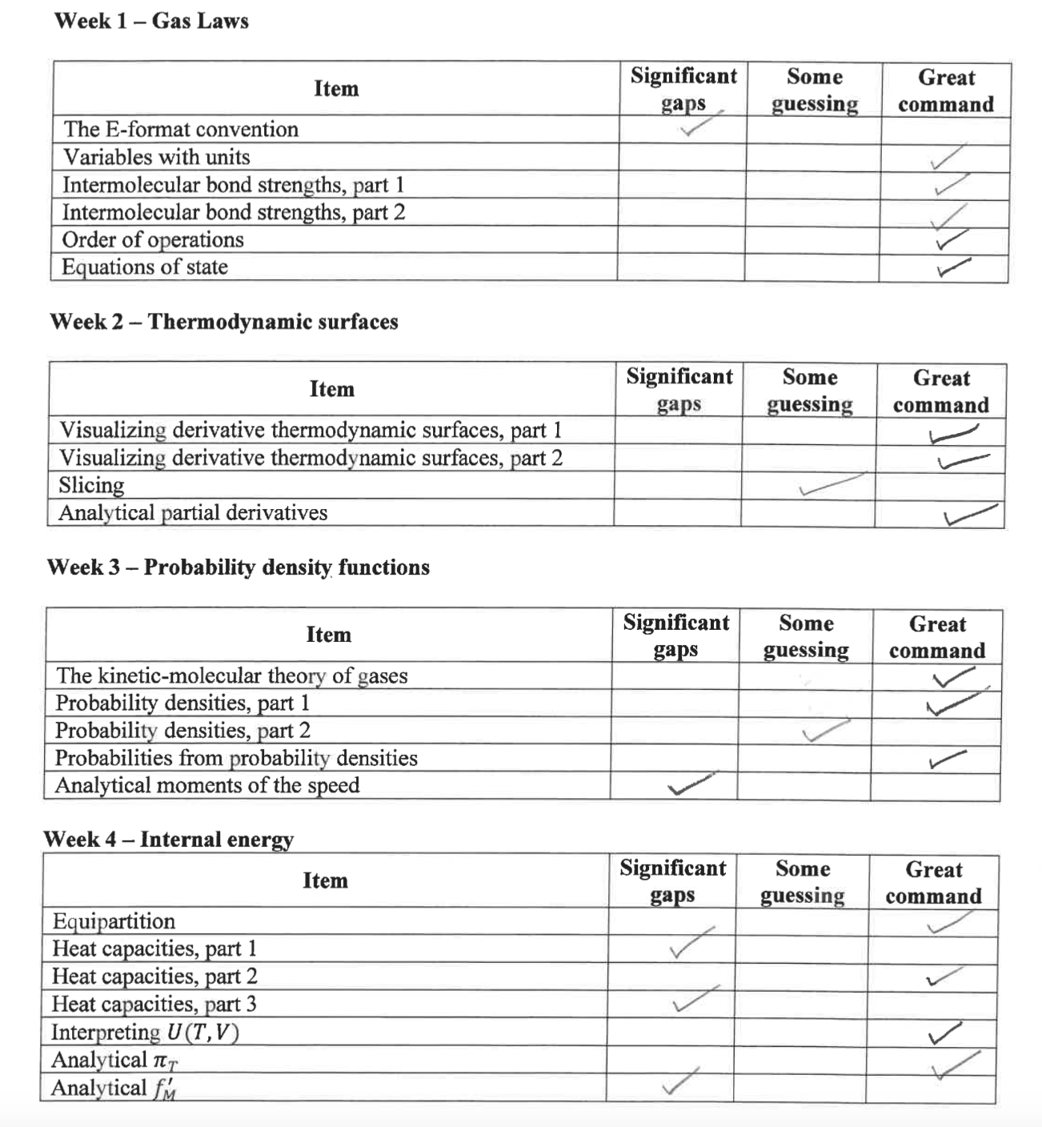
Scoring the 1-on-1 interviews

Slide 7
Coming sooner than we thought: an ice-free summertime Arctic Ocean
We used to think that the first time Arctic sea ice will go entirely away will be some summer in the 2050s (or even later), and after that an infrequent occurrence.
*https://www.nature.com/articles/s41467-023-38511-8
*http://www.climatecodered.org/2023/06/dramatic-arctic-sea-ice-news-should-not.html
https://zacklabe.files.wordpress.com/2023/08/sit_piomas_jul23.gif

Slide 8
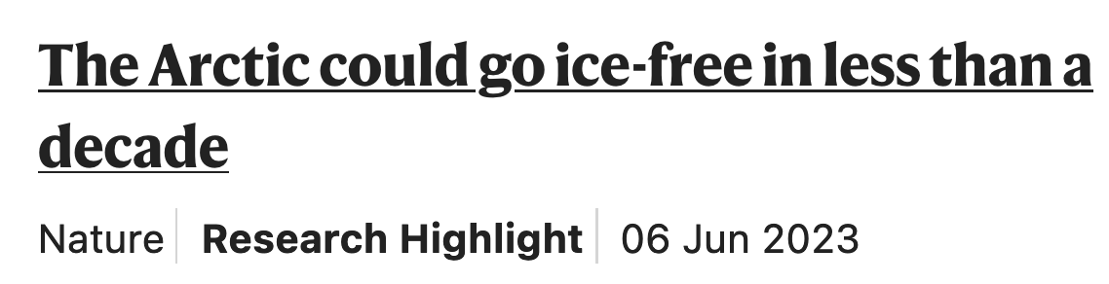
Coming sooner than we thought: an ice-free summertime Arctic Ocean
We used to think that the first time Arctic sea ice will go entirely away will be some summer in the 2050s (or even later), and after that an infrequent occurrence.
*https://www.nature.com/articles/s41467-023-38511-8
*http://www.climatecodered.org/2023/06/dramatic-arctic-sea-ice-news-should-not.html
https://zacklabe.files.wordpress.com/2023/08/sit_piomas_jul23.gif

Slide 9
Coming sooner than we thought: an ice-free summertime Arctic Ocean
We used to think that the first time Arctic sea ice will go entirely away will be some summer in the 2050s (or even later), and after that an infrequent occurrence.
The last ice-free Arctic summer was ~130,000 years ago, when parts of the Greenland ice sheet went away and the West Antarctic Ice Sheet slipped into the ocean, bringing meters of sea level rise.
*https://www.nature.com/articles/s41467-023-38511-8
*http://www.climatecodered.org/2023/06/dramatic-arctic-sea-ice-news-should-not.html
https://zacklabe.files.wordpress.com/2023/08/sit_piomas_jul23.gif

Slide 10
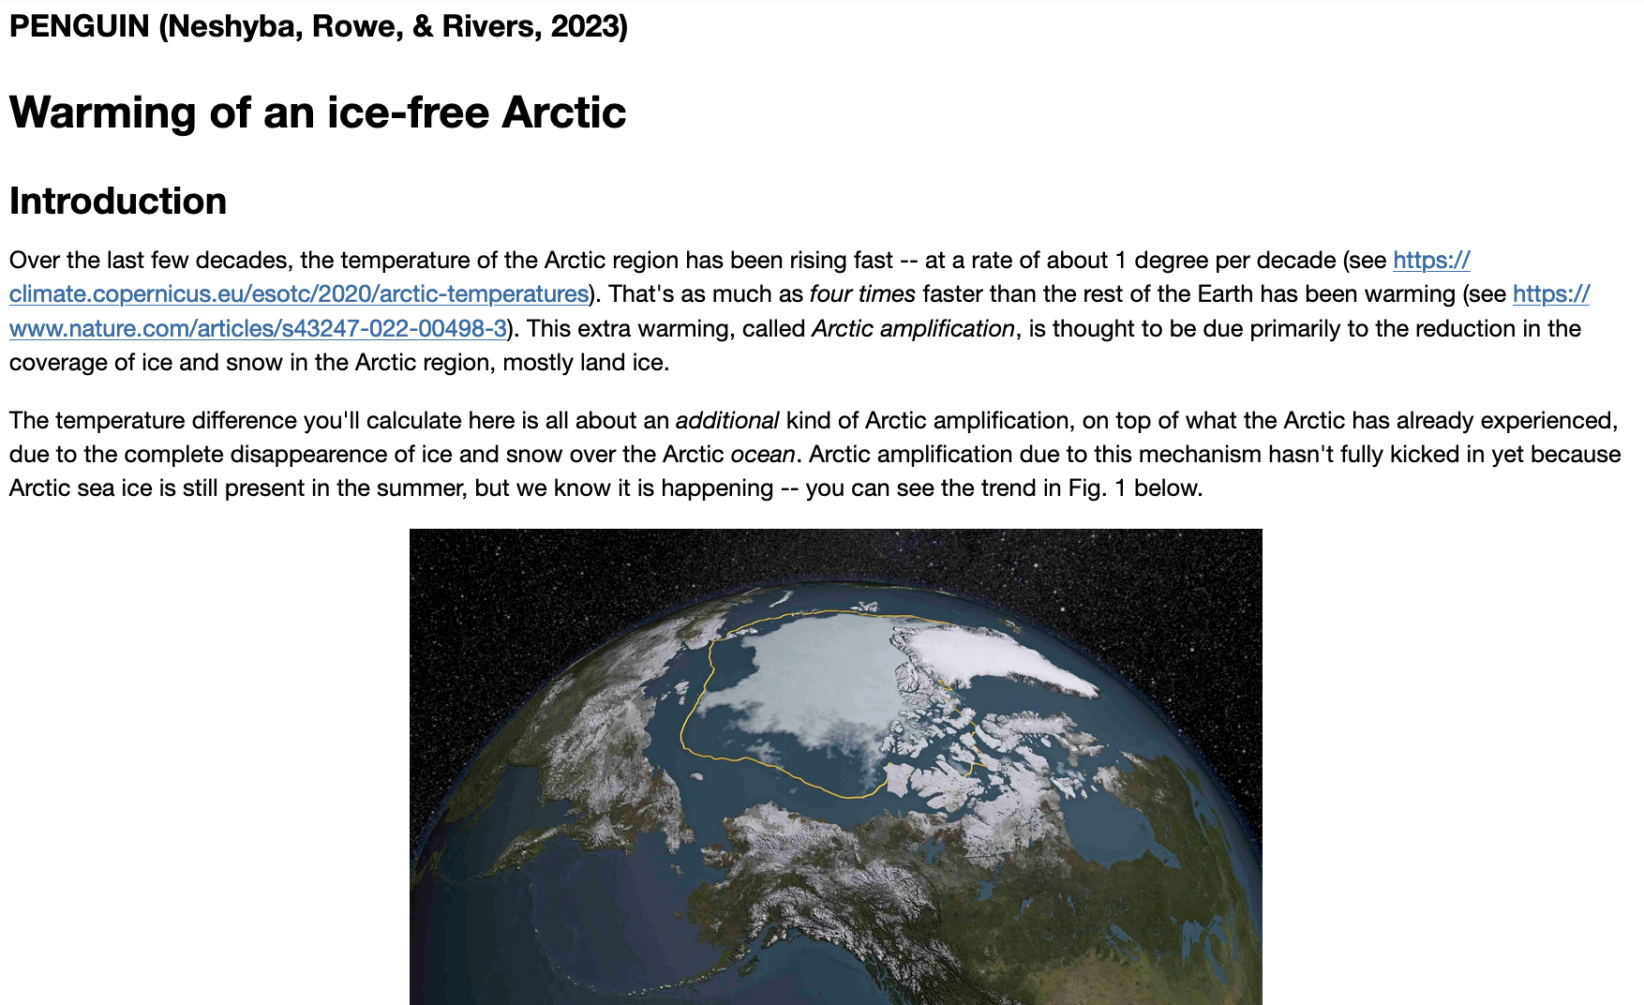
To do sometime next week

